Slide 1
Week 1 Lab
Agenda
Introductions
Technical Skillset Self-test
Git & GitLab
Team Formation
Next Week
Finalise Team Formation
Discuss Project Brief
Plan and Kick-off Sprint 1
COMP9820: Software Project Management

Slide 2
Introductions

Slide 3
Let’s introduce ourselves
In 30 seconds, tell us:
Your name
Your course, any specialisations
Any professional experience (or aspiration)
One fun fact about yourself that nobody would guess

Slide 4

Okay, We’ll start:
Hi, I'm Zayan!
I'm currently doing my undergrad in Software Engineering here at UNSW
Currently, I'm part of a research project that is trying to automate monitoring internet traffic @ UNSW for malicious devices & IoCs
I'm also interning at a start-up company which has created custom agents for clients such as UNSW, NRMA & Newington College
Fun fact about me: I flipped a coin to decide my degree
  (Bonus Points: if you can guess what the other degree was)

Slide 5


Psst... here's some funny photos!

Slide 6
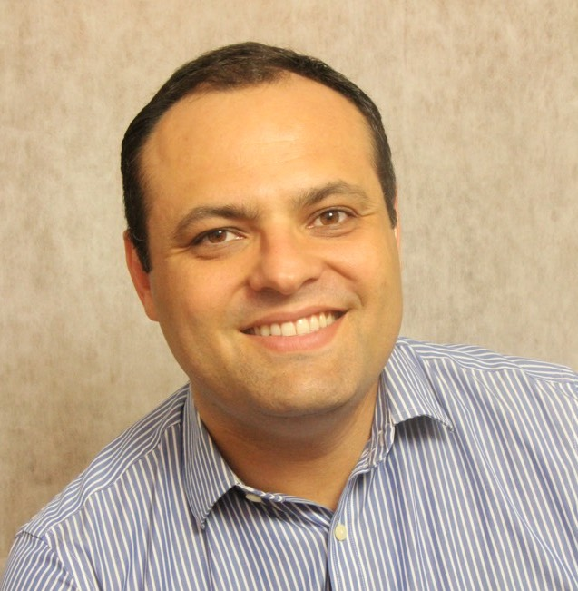
Who am I?
Daniel G. Gotilla
Product Leader with over 20 years of experience developing digital products for the Financial Services, Telecommunications, and Insurance industries in Brazil and Australia. I recently completed a Master’s in Information Technology, specialising in Artificial Intelligence and Bioinformatics, at UNSW.
I wear a few hats in COMP3900/COMP9900: tutor (F11D & F18A), industry client, and admin. I also organise and deliver a couple of workshops (Weeks 2 & 9).

Slide 7
Technical Skillset Self-test

Slide 8
Why we're doing this
Your answers help form project teams. They are not marked and do not affect your course grade.
There is no advantage in overstating or understating your experience. An inaccurate answer mainly means you’ll be placed on a team where the work doesn’t match your skills.
The point is to share a vocabulary for what you can already do, to help you form well-balanced teams.

Slide 9
How to answer
Questions A to F are scored 0 to 4. Choose the highest option for which every part of the description is true of you. If you are between two options, choose the lower one.
Questions G and H are not scored. They are used as constraints when teams are formed.
Write down your answers in a notebook or on your phone/PC’s Notes App:
  A__ B__ C__ D__ E__ F__
  G______________________
  H______________________

Slide 10
A. Agile and Scrum
Which best describes your experience with Agile methods and Scrum?
  0: I haven’t worked with Agile or Scrum and can’t explain what a sprint or a backlog is.
  1: I have read about Agile or covered it in a course but have never worked on a team that used it.
  2: I have worked on a student team that ran sprints, stand-ups or a task board, taking part in the ceremonies without running them.
  3: I have worked on a team in a workplace, internship or substantial project that used Scrum or Kanban, and took part in planning, reviews, retrospectives and backlog refinement.
  4: I have held the Scrum Master or Product Owner role, or set up the process for a team: facilitating ceremonies, maintaining the backlog and adjusting how the team worked.

Slide 11
B. Git, GitHub and GitLab
Which best describes your experience with version control?
  0: I have never used version control of any kind.
  1: I have used Git for my own work: cloning, committing and pushing, mostly on a single branch.
  2: I have worked on branches and used pull or merge requests, and have reviewed others’ code or had my own reviewed.
  3: I have worked in a repository with several active contributors, followed a branching convention, and resolved merge conflicts, rebased, or reverted when needed.
  4: I have set up and administered repositories: branch protection or approval rules, access permissions, tags and releases, and I have helped others recover from Git problems.

Slide 12
C. Front-end web development
Which best describes your web development experience?
  0: I have no web development experience and have never built a web page.
  1: I have written HTML and CSS to build a static page, possibly using JavaScript written by someone else.
  2: I have written my own JavaScript to make a page interactive: handling events, changing the DOM, or validating a form.
  3: I have built a front end with a framework such as React, Vue, Angular or Svelte, with several screens or components that fetch data from an API.
  4: I have built and deployed a substantial front-end application: component structure, state management, routing and API integration, with attention to responsive layout or accessibility.

Slide 13
D. Backend development
Which best describes your backend experience in any programming language?
  0: I have not written server-side code and have little or no programming experience of any kind.
  1: I can program in a language such as Python, Java, C, C++ or JavaScript, but have not written anything that serves requests or stores data.
  2: I have written a small server or API that responds to requests, following coursework or a tutorial.
  3: I have designed and built my own API backed by a database, including schema design, queries, error handling, and some form of authentication.
  4: I have built and deployed a back end that other people used: multiple endpoints or services, authentication, database migrations, automated tests, and a hosted or cloud environment.

Slide 14
E. Project, product and client work
Which best describes your experience coordinating work or dealing with clients/stakeholders?
  0: I have not coordinated a team’s work and have not dealt with a client or external stakeholder.
  1: I have coordinated group work in a student project: dividing tasks, chasing progress, keeping notes or minutes.
  2: I have led a student, volunteer or club project from start to finish, including scope, schedule, and reporting to a supervisor, marker or committee.
  3: I have held paid work with project or product responsibility: maintaining a plan or backlog, reporting status, or dealing directly with clients or customers.
  4: I have been accountable for a project or product in a workplace: setting scope and priorities, managing budget or people, owning client relationships, and reporting to senior staff.

Slide 15
F. CI/CD
Which best describes your experience with continuous integration and continuous delivery?
  0: I have not come across CI/CD and could not say what a build pipeline does.
  1: I know in general terms what CI/CD is from reading or class, but have never used or configured a pipeline.
  2: I have worked in a repository where a pipeline ran on my commits, and have read the results and fixed a failing build or test.
  3: I have written or modified pipeline configuration in GitHub Actions, GitLab CI, Jenkins or similar: adding a job, or changing a test, lint or build step.
  4: I have set up a pipeline from scratch, including automated deployment to a hosted environment and handling secrets, environments or containerised builds.

Slide 16
G. Availability outside the lab
Your team will need to meet outside the lab at least once a week. Which of these windows could you reliably attend, online or in person? Select every one that applies, at least two if you can.
    Weekday mornings, before 12
    Weekday early afternoons, 12 to 3
    Weekday late afternoons, 3 to 6
    Weekday evenings, 6 to 9
    Saturday, daytime
    Sunday, daytime
    Weekend evenings
    I can meet online but cannot come to campus outside my lab time
The windows are deliberately broad. Each team picks its own day and time in Week 2.

Slide 17
H. Expected weekly commitment (not scored)
Setting aside lectures and the lab itself, how much time do you expect to put into the project in a typical week?
    Up to 3 hours
    4 to 6 hours
    7 to 10 hours
    More than 10 hours
Answer what you realistically expect, not what you think is the right answer. Teams work better when members share similar expectations.

Slide 18
Forming your team: coverage
Five or six members. A team of five is not closed. Your tutor may add students until it reaches six.
The total is not the target. What matters is coverage.
A gap is not a problem; it is a plan. Scores of 0 and 1 are expected: the course teaches most of this.
Aim for:
    One person at D3 or above (backend).
    Someone else at C3 or above (frontend), or C2 if nobody higher is available.
    One person at B2 or above (version control).
    Someone willing to coordinate: a higher E helps, but willingness matters more.
  (The above are suggestions, not requirements!)

Slide 19
Forming your team: time
Availability counts more than skill. Find people who share at least two G windows with everyone on the team. If a member can only meet online, the team meets online.
Match commitment expectations. Avoid a team holding both “up to 3 hours” and “more than 10 hours” on H.

Slide 20

Git and GitLab

Slide 21
By the end of this hour, you will have:
An SSH key that identifies your machine to GitLab
A repository on UNSW GitLab, cloned to your machine
Commits you made locally and pushed
A branch, pushed to GitLab
A merge request you opened and merged
A main branch pulled back down with the merge in it

Slide 22
The twelve steps
Why this course starts with Git
Get a Unix terminal; check Git
Tell Git who you are
Log in to GitLab
Add an SSH key
Create your repository
Clone it
Two commits, then push
Make a branch
Merge request, then merge
Check your own work
What comes next

Slide 23
1 — Why a SW project management course starts with Git
From Week 3 you work in a team of five or six in one repository
Two people editing the same file on the same afternoon is normal
Your commit history is the record of who did what and when
Demos are marked on what is on main — work on your laptop does not exist
Merge requests are where code review happens

Slide 24
2 — You need a Unix command line
Not a Git GUI, not the GitLab website. A terminal.
The project needs Unix/Linux: web app, database, container build, CI pipeline
On Windows, that means WSL. Required for the project, not just today.
Your machine | What to open
macOS | Terminal (Cmd+Space, type "Terminal")
Windows, WSL installed | Ubuntu, from the Start menu
Windows, no WSL | See the next slide
Linux | Your usual terminal
Nothing working today | A CSE machine, or VLAB in a browser

Slide 25
2.1 — Installing WSL on Windows
In PowerShell or Windows Terminal, opened as Administrator:
wsl --install
Restart your computer. The installation is not finished until you do.
Open Ubuntu from the Start menu. The first launch takes a minute or two.
Create a UNIX username and password: new and separate from your UNSW account.
The password shows nothing as you type it. That is normal.

Slide 26
2.1 — WSL: what to expect
About a gigabyte to download and a restart. (It may not finish during the lab.)
Start it now, tell your tutor, and use VLAB for the rest of the hour.
Finish at home tonight and redo the lab; fifteen minutes the second time.
If wsl --install fails: run Windows Update, or enable virtualisation in BIOS/UEFI.
Use Git for Windows only if you truly cannot install WSL. (It gets you through today. It will not get you through the project.)

Slide 27
2.2 — Check Git is installed
$ git --version
Do not type the $. It stands for the prompt your terminal already shows you.
If Git is installed, you'll see git version 2.43.0 or similar. If you see "command not found":
WSL / Ubuntu sudo apt update && sudo apt install git
Fedora sudo dnf install git
macOS xcode-select --install
On Windows, install Git inside Ubuntu. Git installed on Windows is not in your WSL terminal.

Slide 28
3 — Tell Git who you are
$ git config --global user.name "Your Full Name"
$ git config --global user.email "z1234567@unsw.edu.au"
$ git config --global pull.rebase false
$ git config --global core.editor "nano"
Your real full name and your zID email. Both appear on every commit.
The last line stops Git from opening Vim. Nano tells you Ctrl+X exits.
Check with: git config --global --list

Slide 29
4 — Log in to GitLab
Go to https://gitlab.cse.unsw.edu.au/
Tick “Remember me” at the bottom of the form
Click "Login with UNSW Single Sign On (SSO)"
Sign in with your zID and zPass
This is UNSW’s GitLab, not gitlab.com. Your account already exists.
If you cannot get in, tell your tutor now. Not at the end of the lab.

Slide 30
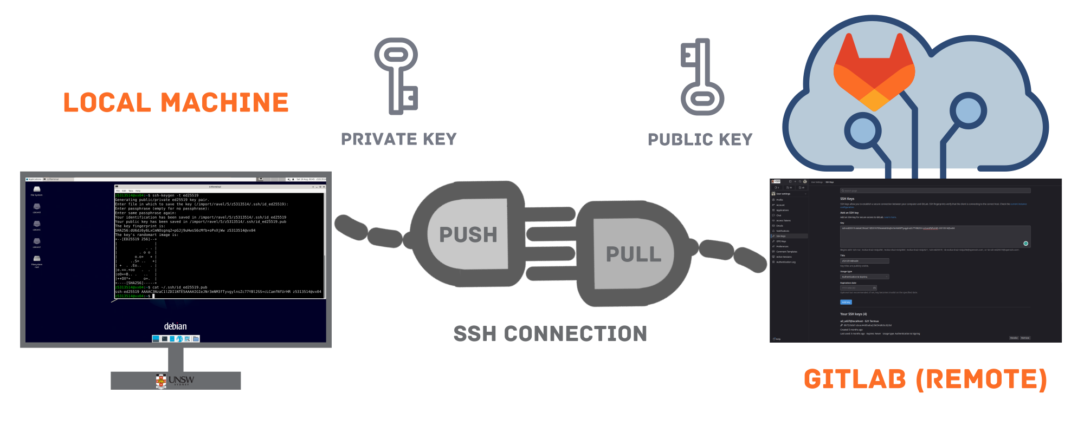
5 — Add an SSH key to GitLab
A private key stays on your machine. The public key goes to GitLab. No password on every push.

Slide 31
5.1 — Do you already have a key?
$ cat ~/.ssh/id_ed25519.pub
Most of you will see:
cat: /home/<you>/.ssh/id_ed25519.pub: No such file or directory
That is the expected answer; go to 5.2
If you see a line starting with ssh-ed25519, you already have a key; skip to 5.3

Slide 32
5.2 — Generate a key
$ ssh-keygen -t ed25519
Three questions. Press Enter for all three: Default file location, empty passphrase, empty passphrase again.
id_ed25519 is private: never paste it, commit it, or send it to anyone.
id_ed25519.pub is public: that is the one you hand to GitLab.

Slide 33
5.3 — Copy the public key
$ cat ~/.ssh/id_ed25519.pub
Copy the whole line, all of it:
ssh-ed25519 AAAAC3NzaC1lZDI1NTE5AAAAIGaEIgJc0mYJRqcoNx44BITl
QFA8cdRIiEh4HgEjf2aQ you@yourlaptop
Or send it straight to the clipboard:
WSL clip.exe < ~/.ssh/id_ed25519.pub
macOS pbcopy < ~/.ssh/id_ed25519.pub
Linux xclip -selection clipboard < ~/.ssh/id_ed25519.pub

Slide 34
5.4 — Paste it into GitLab
Go to gitlab.cse.unsw.edu.au/-/user_settings/ssh_keys
Click “Add new key”
Paste it into the Key box; the Title fills in automatically.
Leave the expiry date alone, click “Add key”

Slide 35
5.5 — Prove it works
$ ssh -T git@gitlab.cse.unsw.edu.au
First time it asks whether you trust the server. Type yes in full, not y.
Welcome to GitLab, @z1234567!
A line about PTY allocation failing is normal. Ignore it.
Permission denied (publickey) means the key did not get across; redo 5.3 and 5.4.

Slide 36
6 — Create your repository
Click + in the top bar, then New project/repository
Choose “Create blank project”
Project name: comp9820-lab01-git
Leave the namespace as your own username
Visibility: Private
Tick “Initialize repository with a README”
Click Create project

Slide 37
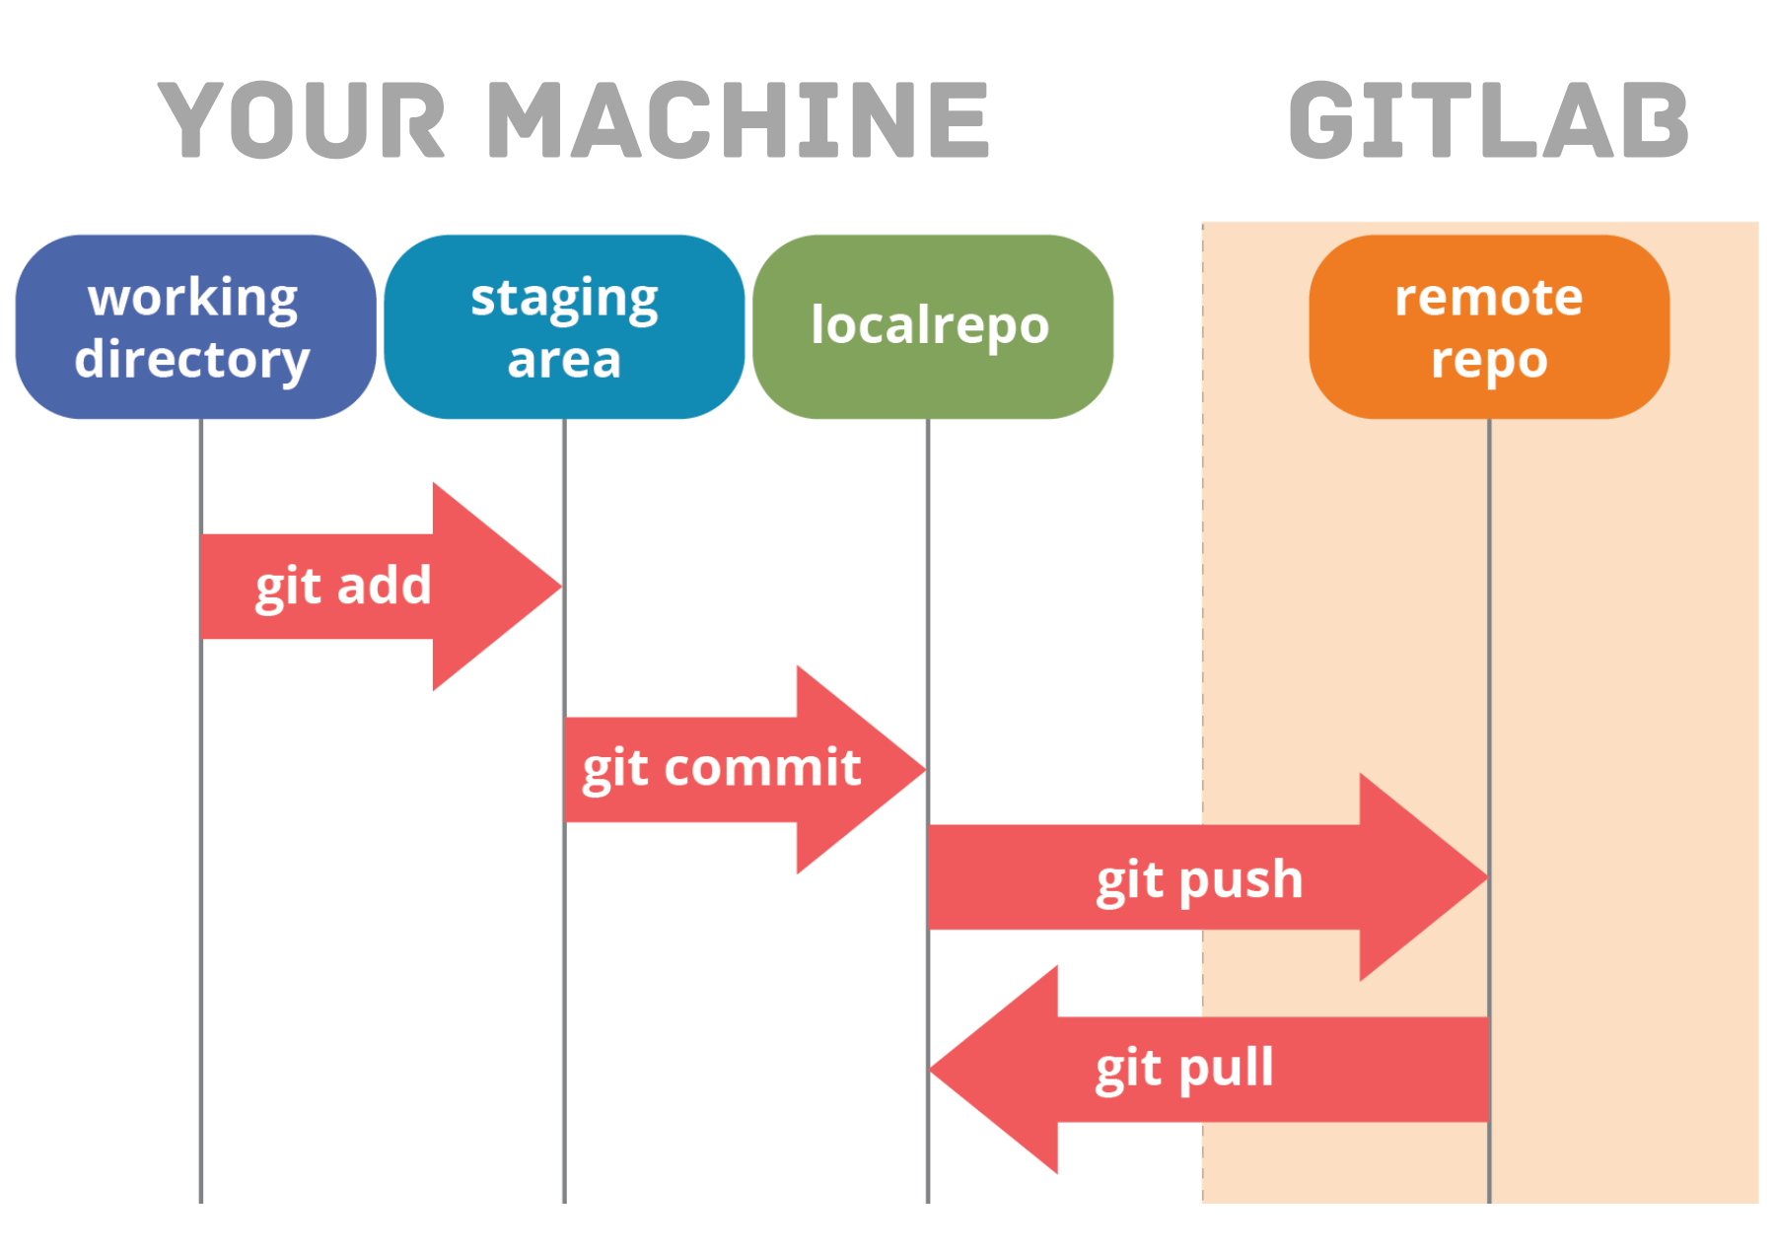
Where your work lives

Slide 38
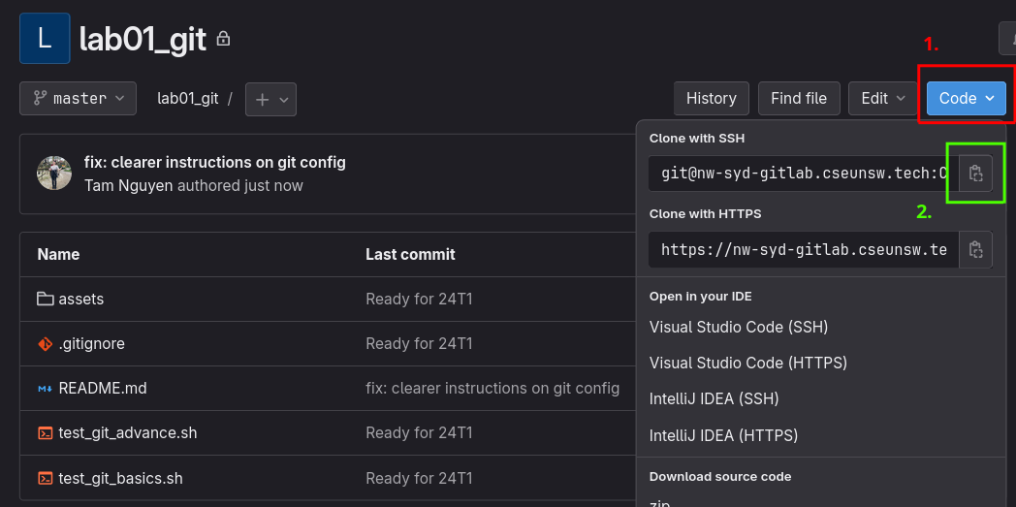
7 — Copy the SSH URL
Blue Code button, top right. Select “Clone with SSH”. It must start with git@, not https://
(Screenshot from an earlier offering: your project name and the host will look different.)

Slide 39
7 — Clone it to your machine
$ mkdir -p ~/comp9820
$ cd ~/comp9820
$ git clone git@gitlab.cse.unsw.edu.au:z1234567/comp9820-lab01-git.git
$ cd comp9820-lab01-git
$ ls
ls should show README.md
Asked for a password? You copied the HTTPS URL. Start again with the git@ one.
On WSL, clone into your Linux home as shown; not into /mnt/c/...

Slide 40
8 — A commit takes two steps
git add stages a change. It means "include this in the next commit”.
git commit records everything staged, with a message
Neither of them touches GitLab
git push does that

Slide 41
8 — Watch git status change
$ echo "I am first" > first.txt
$ ls
$ git status
first.txt is untracked: it is in the folder, and Git is not looking after it yet.
$ git add first.txt
$ git status
It is now selected to be committed. But nothing has been recorded yet.

Slide 42
8 — Commit, then commit again
$ git commit -m "Add first.txt with an opening line"
$ git status
The commit is on your machine. git status says you are ahead of origin/main by one commit.
$ echo "I am still first" >> first.txt
$ git add first.txt
$ git commit -m "Add a second line to first.txt"
$ git log --oneline

Slide 43
8 — Push it to GitLab
$ git push
$ git status
Refresh the project page on GitLab
Both commits are there, first.txt is there, your name is next to them

Slide 44
8.1 — Commit messages
Write what changed and, where it is not obvious, why. These become your sprint reports.
Poor | Better
fix | Fix crash when the booking form is submitted empty.
update stuff | Add validation for the date field.
asdf | Remove the debug print from the login handler.

Slide 45

9 — Branches
A branch lets you work on the same files without disturbing each other.
(The diagram says Master; in our repositories, that branch is called main.)

Slide 46
9 — Make a branch and commit on it
$ git checkout -b add-second-file
$ git branch
$ echo "I am second" > second.txt
$ git add second.txt
$ git commit -m "Add second.txt"
$ git push
Branch names describe the work: add-second-file, fix-login-validation
Not branch2. Not your own name.

Slide 47
9 — That push fails. Read the error.
fatal: The current branch add-second-file has no upstream branch.
To push the current branch and set the remote as upstream, use
git push --set-upstream origin add-second-file
The branch exists only on your machine. GitLab has never heard of it. Do as it says:
$ git push -u origin add-second-file
Only needed the first time you push a new branch. Keep this output on the screen; you need the link.

Slide 48
10 — Why a merge request
On your own repo, you could merge from the command line. You are not going to.
In the group project, main is protected which you can't push your code directly into there; the only way in is a merge request.
A merge request is a proposal: here are my commits, please put them on main
It is where review comments are made, and where CI results appear from Week 3

Slide 49
10 — Open it, then merge it
Click the merge request link printed by your push
Title: Add second.txt. Write a real description (a sentence or two).
Click Create merge request
Look at the Changes tab; this is what a reviewer sees: the diff, not your files
Untick “Delete source branch when merge request is accepted” (for this lab only)
Click Merge

Slide 50
10 — Bring the merge back down
$ git checkout main
$ git pull
$ ls
$ git log --oneline --graph --all
second.txt is there, and the graph shows your branch joining main
git pull is the command you will run most often this term
Always pull before you start work. Every single time.

Slide 51
11 — Check your own work
Paste the block from the lab handout to create the two scripts, then:
$ bash test_git_basics.sh
$ bash test_git_advance.sh
You want Tests passed from each
Nothing is submitted, and none of this is marked
Then run git status: the two scripts sit there untracked, just like first.txt did.

Slide 52
12 — The five commands that carry the work
Command | What it does
git status | What is going on right now. Run it constantly.
git pull | Bring down other people’s work. Run it before you start.
git add / git commit | Record your work locally, with a message.
git push | Send it to GitLab.
git checkout -b | Start a branch for a piece of work.

Slide 53
12 — Before the Week 2 lab
Make the whole loop work on the machine you will use for the project
With WSL, if you are on Windows
Week 2 forms teams and moves to GitLab issues, boards and milestones
It assumes today’s setup is done
Ask your tutor for help now if anything didn’t work. Cheaper to fix in Week 1 than in Week 3 with a sprint running.

Slide 54
If you finish early
Cause a merge conflict on purpose, and resolve it (edit third.txt on both branches)
Edit first.txt in the GitLab web editor, then git pull it down
Try git diff before you add, and git diff --cached after
Atlassian’s Git guide: https://www.atlassian.com/git

Slide 55
Team Formation

Slide 56
Use this time to find a team
You must join a team in the lab that matches your lab enrolment.
Teams should have at least 5 members, ideally 6. (Tutors and Admins may add students to any team that does not yet have 6 members.)
Use the Technical Skillset Self-Test we did earlier to help guide the process. Remember, a balanced team is better than one where everyone scores high in the same skills.
Formalise your team: Log in to Moodle -> select this course, open the “Team Formation” page and join a team in your lab.
Don’t worry: We will finalise Team Formation in Week 2.

